Slide 1
Multiscale Attention Gated Network (MAGNet) for Retinal Layer and Macular Cystoid Edema Segmentation
By
PARVATHY G S
ENROLMENT NO:811221065)

Slide 2
Abstract
With non-invasive and high-resolution properties, optical coherence tomography (OCT) has been widely used as a retinal imaging modality for the effective diagnosis of ophthalmic diseases. The retinal fluid is often segmented by medical experts as a pivotal biomarker to assist in the clinical diagnosis of age-related macular diseases, diabetic macular edema, and retinal vein occlusion.This project uses different deep learning paradigms for the retinal fluid segmentation in OCT images. The deep learning architectures include the backbone of convolutional neural network (CNN) and fully convolutional network (FCN). The proposed method introduces a novel FCN architecture that leverages spatial and channel-attention gates at multiple scales for fine-grained segmentation and a weighting loss approach to handle class imbalance.

Slide 3
Contents
Introduction
Software Specification
Hardware Specification
Existing System
Proposed System
Algorithms
Literature Survey
Achitectural Diagram
Dataflow Diagram
Conclusions
References

Slide 4
Introduction
Due to its non-invasive nature and high resolution, optical coherence tomography (OCT) imaging is a widely used diagnostic tool in the characterization of retinal pathologies such as diabetic macular edema (DME), age-related macular degeneration (AMD), and retinal vein occlusion (RVO).
The quantification of diagnostic findings in OCT images is central to detecting sight-threatening conditions and relies on the accurate segmentation of anatomical landmarks and abnormal structures.
A novel lightweight fully convolutional neural network (FCN) for end-to-end automatic segmentation of retinal layers and macular cystoid edema (MCE) in OCT images

Slide 5
The proposed network builds upon the encoder-decoder architecture and attention-gated framework to exploit pixel-wise spatial information for fine-grained segmentation
To train the segmentation model, we propose a novel loss-weighting approach based on the Euclidean distance transform tailored to handle class imbalance.
The proposed method derives pixel-wise loss weightings directly from the data without adding training hyperparameters

Slide 6
Software Requirements
Operating System: Windows 10 or higher
Environment: Visual Studio 2022
Server – IIS
Front end : ML.Net and C#
Database: SQL Sever 2022 or higher
Hardware Requirements
CPU: Intel Core 2 Quad CPU Q9400 2.66GHZ (minimum)
Memory: 4GB SDRAM (minimum)

Slide 7
Existing System
Existing system that identifies different stages of Macular Edema based on blood vessels, haemorrhage and exudates.
The features are extracted using image pre-processing and they are fed into the neural network.
SVM based training provided into the data and classify the images into three categories as mild Macular Edema , moderate Macular Edema and advanced Macular Edema .
But the system could not give expected results if the exudate areas in the fundus exceeds that of an optical disc size

Slide 8
Disadvantages of Existing System
Among other existing supervising algorithms, most of them are requiring more pre-processing or post-processing stages for identifying the different stages of the Macular edema.
Also some other algorithms mandatorily requiring manual feature extraction stages to classify the fundus images

Slide 9
Proposed System
This project proposes a novel loss-weighting approach based on the Euclidean distance transform tailored to handle class imbalance.
The proposed method derives pixel-wise loss weightings directly from the data,eliminating the need for additional training hyperparameters.
This methodology introduces two attention gates to capture channel and spatial correlations within intermediate feature maps. These gates provide a mechanism for improving the allocation of computational resources toward the most informative features for the segmentation task.

Slide 10
The proposed attention gates are integrated into a novel fully-convolutional network, which delivers state-of the-art results while using fewer parameters than compared to other networks.
The main functionalities of the network include
i) Data Augmentation
ii) Pre-processing
iii) Initialization of Networks
iv) training
v) Activation function selections
vi) Regularizations

Slide 11
ADVANTAGES
The proposed FCN is based on the widely-used encoderdecoder architecture, which has proven to be a suitable framework for image segmentation
No manual feature extraction stages are needed.
Our network architecture with dropout techniques yielded significant classification accuracy .
True positive rate(or recall) are also improved.

Slide 12
Literature Survey
Paper1: Kernel regression based segmentation of optical coherence tomography images with diabetic macular edema
Author: S. J. Chiu, M. J. Allingham, P. S. Mettu, S. W. Cousins, J. A. Izatt, and S. Farsiu
Methodology:
This proposed methodology develops a fully automatic algorithm to identify fluid-filled regions and segment seven retinal layers in spectral domain optical coherence tomography images of eyes with diabetic macular edema (DME).
To achieve this, the authors developed a kernel regression (KR)-based classification method to estimate fluid and retinal layer positions followed by a graph theory and dynamic programming framework for more accurate boundary segmentation
The algorithm was validated on 110 B-scans from 10 patients

Slide 13
Paper 2:Epiretinal membrane detection in optical coherence tomography retinal images using deep learning
Author: E. Parra-Mora, A. Cazanas-Gordon, R. Proenca
Methodology:
The proposed solution is based on four widely used convolutional neural network architectures adapted to the task using transfer learning, and fine-tuned with a proprietary dataset.
The architectures were specialized by optimizing the network hyperparameters and two loss functions, cross-entropy and focal loss were used.

Slide 14
Paper 3: Automatic retinal and choroidal boundary segmentation in OCT images using patch-based supervised machine learning methods
Author: D. Alonso-Caneiro, J. Kugelman, J. Hamwood
Methodology:
In this work, two different deep learning methods; convolutional neural networks (CNN) and recurrent neural networks (RNN) are evaluated to calculate the probability of locating retinal and choroidal boundaries of interest to be located in a specific position within the SD-OCT images

Slide 15
Paper 4: Automatic segmentation of retinal layer boundaries in OCT images using multiscale convolutional neural network and graph search
Author: K. Hu, B. Shen, Y. Zhang, C. Cao, F. Xiao
Methodology:
They construct a MCNN architecture by fusing feature maps extracted from different sizes of input image patches to learn multiscale information about the retinal layer boundaries.
Meanwhile, we distinguish the background pixels based on the location information to reduce the probability that the network misclassifies the background as a target.

Slide 16
Paper 5: Deep learning based retinal OCT segmentation
Author: M. Pekala, N. Joshi, T. Y. A. Liu, N. M. Bressler
Methodology:
This method proposed a novel method for automated segmentation of OCT, using deep learning, and particularly combining fully convolutional networks with Gaussian processes. resulting in the smallest mean unsigned error values

Slide 17
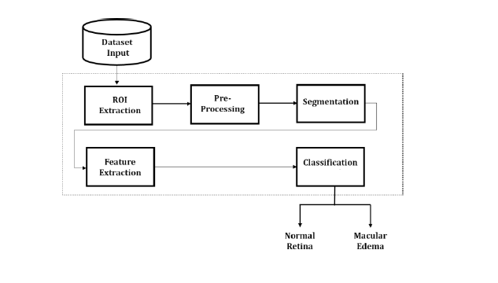
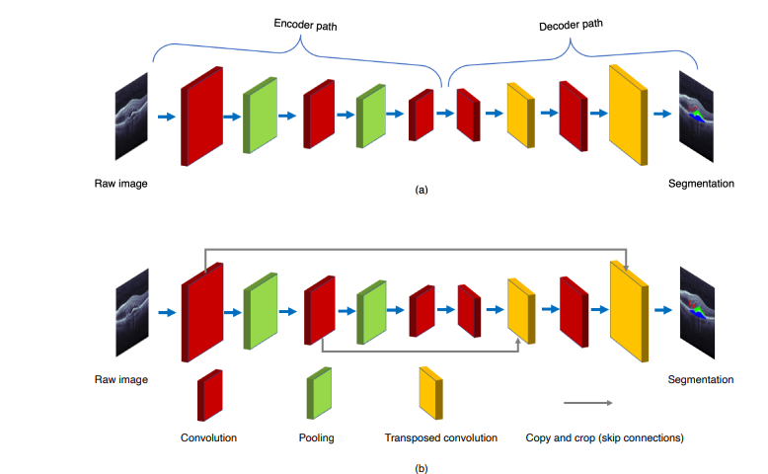
Architecture Diagram

Slide 18
DATASET DESCRIPTION
The OCTID (OCT Image Database) contains OCT images of the retina for various retinal diseases. It is commonly used for training deep learning models to classify and segment abnormalities like macular edema and diabetic retinopathy.This dataset is designed specifically for the segmentation of retinal layers from OCT images. It includes a series of OCT images of the retina, as well as manual annotations of the retinal layers, which is useful for feature extraction and segmentation tasks. Many datasets require preprocessing before use, such as image resizing, normalization, and noise reduction..

Slide 19
IMPLEMENTATION DETAILS
Step 1: Upload Image for Training
Step 2: Image Preprocessing contains Image Resizing and Image Normalization
Step 3: Image Augmentation
Step 4: Segmentation Mask Processing
Step 5: To train a deep learning model CNN for classification
Step 6: Evaluate the model’s performance using metrics
Step 7: Upload Image for Detection
Step 8: Model Matching and Detection

Slide 20
Algorithm Used
Data Segmentation Algorithm
SVM based Feature Classification Architecture

Slide 21
Algorithm1
The steps in the Medical data segmentation technique includes:-
1. The color_space conversion from RGB to YCbCr of an input image is performed to generate less correlated component planes.
2. Each component plane is transformed and quantized to reduce inter pixel correlation and packing pixel into few transform coefficients.
2.1. The plane is divided into non-overlapping NxN blocks.
2.2. The blocks are transformed and quantized by blocked Int DCT.

Slide 22
3. The quantized coefficients of each component plane are encoded using a hardware efficient encoder.
3.1. The coefficients of a block are partitioned into AC and DC coefficients.
3.2. DC coefficients are differentially encoded and mapped to non-negative integer.
3.3. The resultant coefficients are further encoded using AGR coding.
3.4. The AC coefficients are scanned along a zigzag order and non zero AC components are also mapped to non zero positive integers.
3.5. A pair consisting of non zero AC coefficients and run length of the succeeding zero value AC coefficients is encoded using the AGR encoder
3.6. Each zero AC coefficient is assigned the value 0.

Slide 23
Algorithm 2
SVM based Feature Classification Architecture
When the average thickness of the entire image was evaluated, the resulting thickness did not show much variation between normal and diseased images.
This shortcoming is overcome by splitting the segmented images into five equal regions such that the central region consists of the fovea of the macula
This region splitting can be attributed to the fact that macular edema or macular inflammation is prominent in the foveal region.
The average thickness of each region between the ILM and the RPE is evaluated.
The thickness measure of the foveal region is comparatively higher for the images that have inflammation (edema) and lesser for normal images.

Slide 24
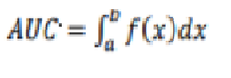
The Inner Limiting Membrane (ILM) and the Retinal Pigment Epithelium (RPE) layers of the retina enclose the area covered by the macula of the retina in the OCT scan.
Due to the inflammation of the macula in case of Macular Edema, the area enclosed by these two layers is comparatively larger than the same in case of normal eye.
Using Area Under the Curve (AUC) technique, the area between the ILM and RPE layers were estimated and this metric is used as one of the parameters to train the classifier
The area under a curve between two points can be determined by using a definite integral between the two points. The area under the curve y=f(x) between limits x=a andx=b can calculated using the formula

Slide 25
While estimating the area between ILM and RPE the area under ILM is named A1 and the area under RPE is named A2, and the difference between these two areas is observed as the area enclosed by the two desired layers.
The binary classification of the images into normal and diseased is performed by using linear Support Vector Machine (SVM) classifier.
SVMs are supervised learning models used for data classification.
The SVM model is trained using a dataset with samples labelled with the class they belong to. Here, normal OCT images belong to class 0 and edema affected OCT images belong to class 1.
The SVM model is being trained with 13 features namely, five regionwise thickness measures, area of fluid between ILM and RPE layers, four textural features – energy, contrast, homogeneity and entropy, three wavelet features from level 1 decomposition - two averages and energy.

Slide 26


RESULT ANALYSIS
PERFORMANCE METRICES
Earlier the model were trained with less raw images and that caused decrease in accuracy when classifying the human in realtime with different surrounding conditions. This problem was overcame by creating our own dataset which resembled realtime images to train the Model.
EVALUATION METRICS
This work is assessed using Accuracy, Precision, Recall and F1-Score metrics,True positives and negatives .

Slide 27
CONFUSION MATRIX
The confusion matrix consists of four key metrics:
True Positives (TP): The number of samples correctly predicted as positive
True Negatives (TN): The number of samples correctly predicted as negative
False Positives (FP): The number of samples incorrectly predicted as positive
False Negatives (FN): The number of samples incorrectly predicted as negative

Slide 28
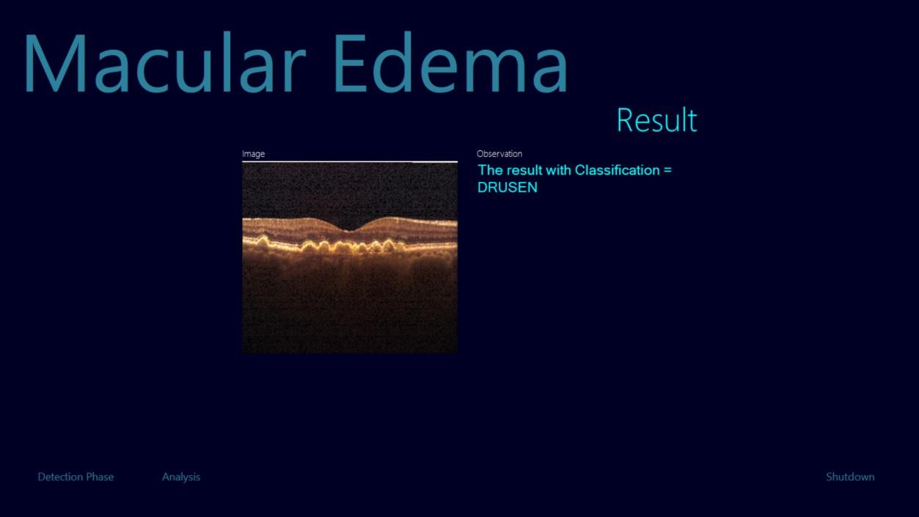
RESULTS

Slide 29
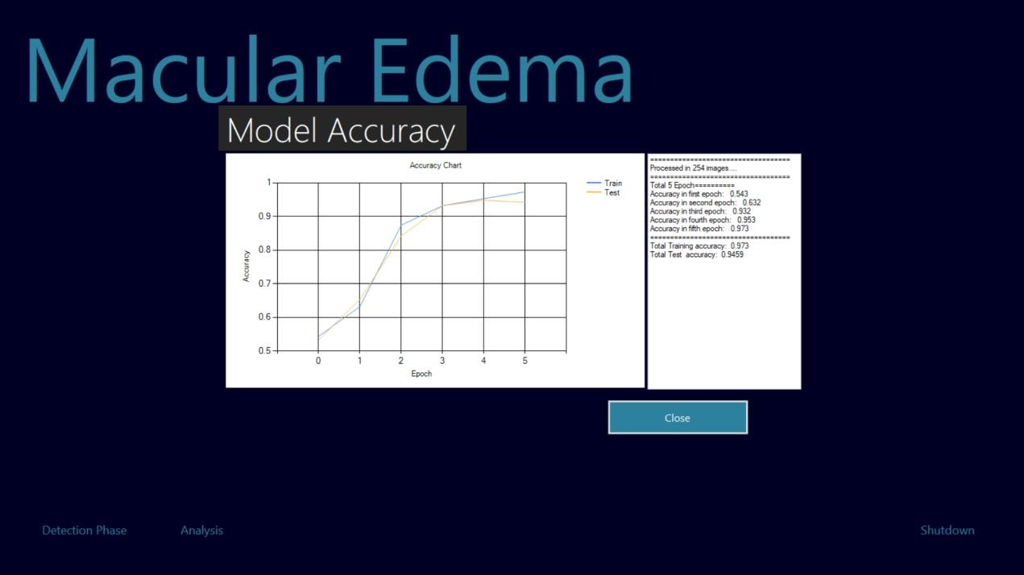
MODEL ACCURACY

Slide 30
RESULT COMPARISON WITH BASEPAPER
Earlier the model were trained with less raw images and that caused decrease in accuracy when classifying the human with different surrounding conditions. This problem was overcame by creating our own dataset which resembled realtime images to train the Model. Second major problem was that many of the literature surveys tried gender classification but did not perform on realtime, while had slow performance in classifying the real-time feed instantly. This was solved by giving the model the required data and adding the right layers on the right places such as dropout and batch normalization in order to prevent overfitting on the training data.

Slide 31
RESULT COMPARISON
To evaluate the effectiveness of these models, the proposed method was evaluated with The accuracy rate.
MODEL | ACCURACY
CNN MODEL | 93
CNN SVM MODEL | 97

Slide 32
Conclusion
This study proposes a novel end-to-end automatic method for segmenting retinal layers and macular cystoid edema in OCT B-scans.
The proposed method addresses the need for automating retinal OCT image analysis, which is a labor intensive task, prone to human error and inter-observer variability.

Slide 33
FUTURE SCOPE
The integration of artificial intelligence, multimodal imaging, portable devices, and advanced software algorithms will enhance the accuracy, accessibility, and personalization of OCT-based assessments. With these advances, OCT will continue to play a pivotal role in the early detection, monitoring, and personalized treatment of macular edema
The future of OCT may include using deep learning models not only for detecting edema but also for predicting disease progression, the likelihood of recurrence, and potential treatment responses, allowing for proactive management of patients.

Slide 34
REFERENCES
[1] S. J. Chiu, M. J. Allingham, P. S. Mettu, S. W. Cousins, J. A. Izatt, and S. Farsiu, ‘‘Kernel regression based segmentation of optical coherence tomography images with diabetic macular edema,’’ Biomed. Opt. Exp., vol. 6, no. 4, pp. 1172–1194, 2015, doi: 10.1364/BOE.6.001172.
[2] S. P. K. Karri, D. Chakraborthi, and J. Chatterjee, ‘‘Learning layer-specific edges for segmenting retinal layers with large deformations,’’ Biomed. Opt. Exp., vol. 7, no. 7, pp. 2888–2901, 2016.
[3] A. Rashno, D. D. Koozekanani, P. M. Drayna, B. Nazari, S. Sadri, H. Rabbani, and K. K. Parhi, ‘‘Fully automated segmentation of fluid/cyst regions in optical coherence tomography images with diabetic macular edema using neutrosophic sets and graph algorithms,’’ IEEE Trans. Biomed. Eng., vol. 65, no. 5, pp. 989–1001, May 2018.
[4] J. Oliveira, S. Pereira, L. Gonçalves, M. Ferreira, and C. A. Silva, ‘‘Multisurface segmentation of OCT images with AMD using sparse high order potentials,’’ Biomed. Opt. Exp., vol. 8, no. 1, pp. 281–297, 2017.
[5] E. Parra-Mora, A. Cazanas-Gordon, R. Proenca, and L. A. da Silva Cruz, ‘‘Epiretinal membrane detection in optical coherence tomography retinal images using deep learning,’’ IEEE Access, vol. 9, pp. 99201–99219, 2021, doi: 10.1109/ACCESS.2021.3095655.

Slide 35
[6] D. Alonso-Caneiro, J. Kugelman, J. Hamwood, S. A. Read, S. J. Vincent, F. K. Chen, and M. J. Collins, ‘‘Automatic retinal and choroidal boundary segmentation in OCT images using patch-based supervised machine learning methods,’’ in Proc. Comput. Vis. ACCV Workshops, G. Carneiro and S. You, Eds. Cham, Switzerland: Springer, 2019, pp. 215–228, doi: 10.1007/978-3-030-21074-8_17.
[7] K. Hu, B. Shen, Y. Zhang, C. Cao, F. Xiao, and X. Gao, ‘‘Automatic segmentation of retinal layer boundaries in OCT images using multiscale convolutional neural network and graph search,’’ Neurocomputing, vol. 365, pp. 302–313, Nov. 2019, doi: 10.1016/j.neucom.2019.07.079.
[8] M. Pekala, N. Joshi, T. Y. A. Liu, N. M. Bressler, D. C. DeBuc, and P. Burlina, ‘‘Deep learning based retinal OCT segmentation,’’ Comput. Biol. Med., vol. 114, Nov. 2019, Art. no. 103445, doi: 10.1016/j.compbiomed.2019.103445.
[9] P. Zang, J. Wang, T. T. Hormel, L. Liu, D. Huang, and Y. Jia, ‘‘Automated segmentation of peripapillary retinal boundaries in OCT combining a convolutional neural network and a multi-weights graph search,’’ Biomed. Opt. Exp., vol. 10, no. 8, pp. 4340–4352, 2019.
[10] J. Kugelman, D. Alonso-Caneiro, Y. Chen, S. Arunachalam, D. Huang, N. Vallis, M. J. Collins, and F. K. Chen, ‘‘Retinal boundary segmentation in stargardt disease optical coherence tomography images using automated deep learning,’’ Transl. Vis. Sci. Technol., vol. 9, no. 11, p. 12, Oct. 2020, doi: 10.1167/tvst.9.11.12. [11] A. Cazanas-Gordon, E. Parra-Mora, and L. A. D. S. Cruz, ‘‘E

Slide 36
THANK YOU

